Slide 1
CAS: AI and Creative Practices
Module 6:
LLMs as Agents

Slide 2
1. Chain of thought
Sequences of tasks that require „thinking“ and build on each other
2. Agents
Sequences of tasks that require „thinking“ and decision making (e.g. chose a tool) and that build on each other

Slide 3
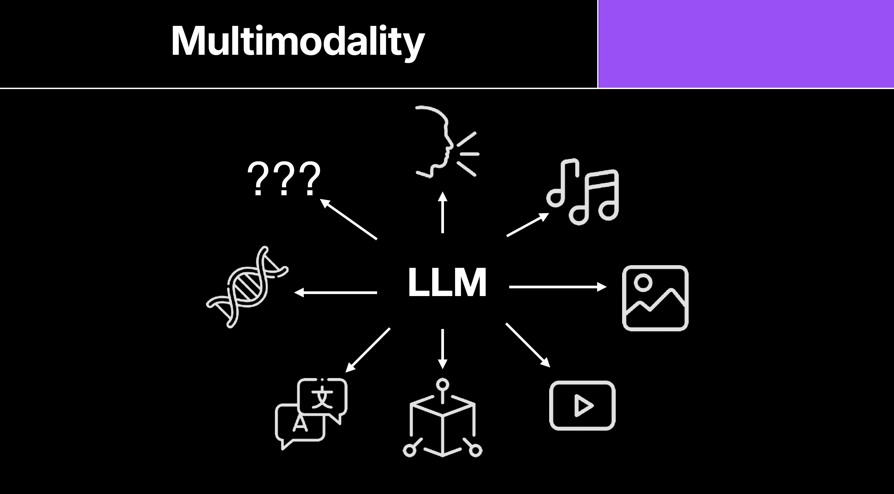
Guilaume Witz

Slide 4
Eric Pritchet (IBM) 2025
https://www.youtube.com/watch?v=OFq_CvRCpA0
MCP (Model Context Protocol) server is a program that connects AI models, like LLMs, to external tools, data, and systems (e.g., databases, GitHub, Slack) using a standardized way to share context, enabling the AI to access live information and perform actions beyond its training data, facilitating tasks like fetching real-time data, running code, or managing workflows.
Guilaume Witz

Slide 5
Discriminative AI
(Classifier)
Generative AI
Transformer Architecture (NLP)
Diffusion Models (Vision)

Slide 6
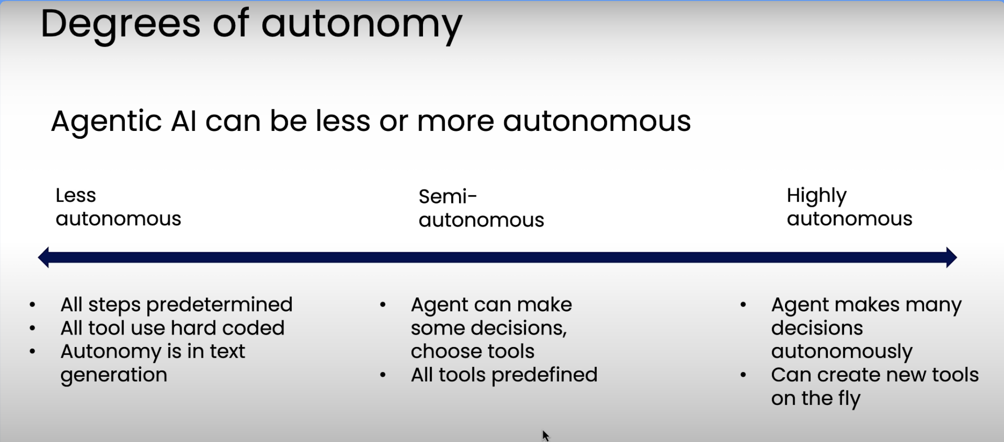
Andrew Ng, Deeplearning

Slide 7
Wording:
Instead of „Agents“ speak of „Agentic Workflows“
Andrew Ng

Slide 8
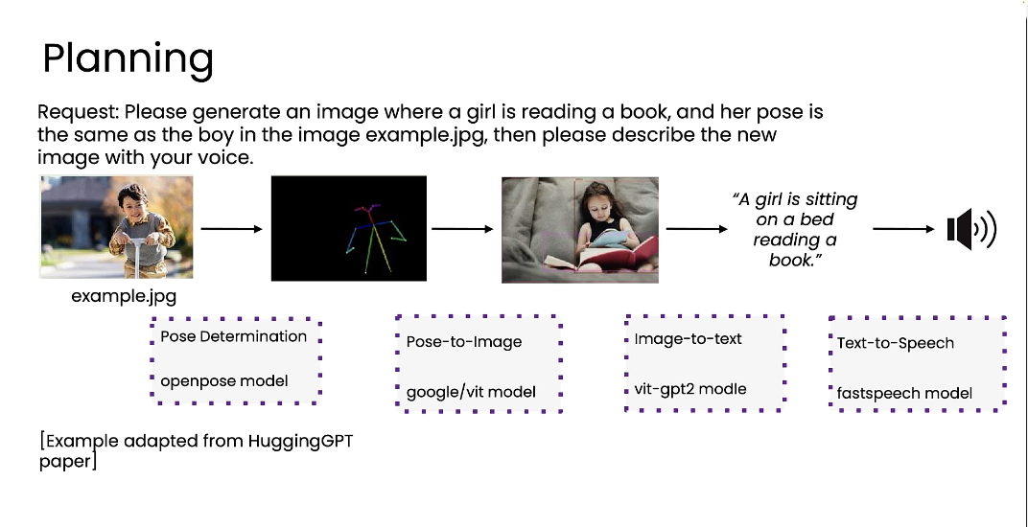

Slide 9
Find a Partner and discuss:
Think of AI as a partner in your project
Is it a partner for the user or the artist (or both)?
What should it perceive (input, sensors, dataformat, categories, clusters etc.)?
How should it behave (output, determistic, random, conditional, tools etc.)
How will the user/audience or artist feel the AI?

Slide 10
Designing an Agentic Workflow

Slide 11
„The body“: Data Flow Diagram
„The behavior“: State Diagram
„The dramaturgy“: Sequence Diagram

Slide 12
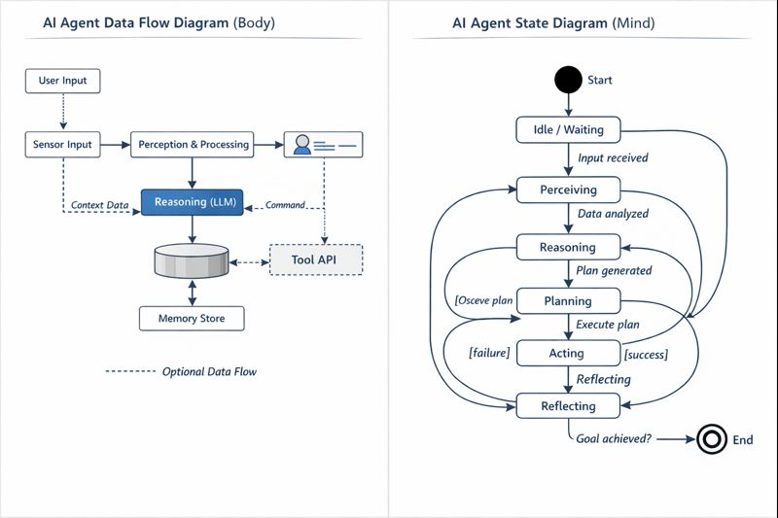
Generated with ChatGPT

Slide 13
Data Flow Diagram (DFD)
Data Base/ Data Store:
Permanent storage of data.

Slide 14
Data Flow Diagram (DFD)
process:
An activity that transforms input data into output data.

Slide 15
Data Flow Diagram (DFD)
Data flow:
Transferring data from A to B.

Slide 16
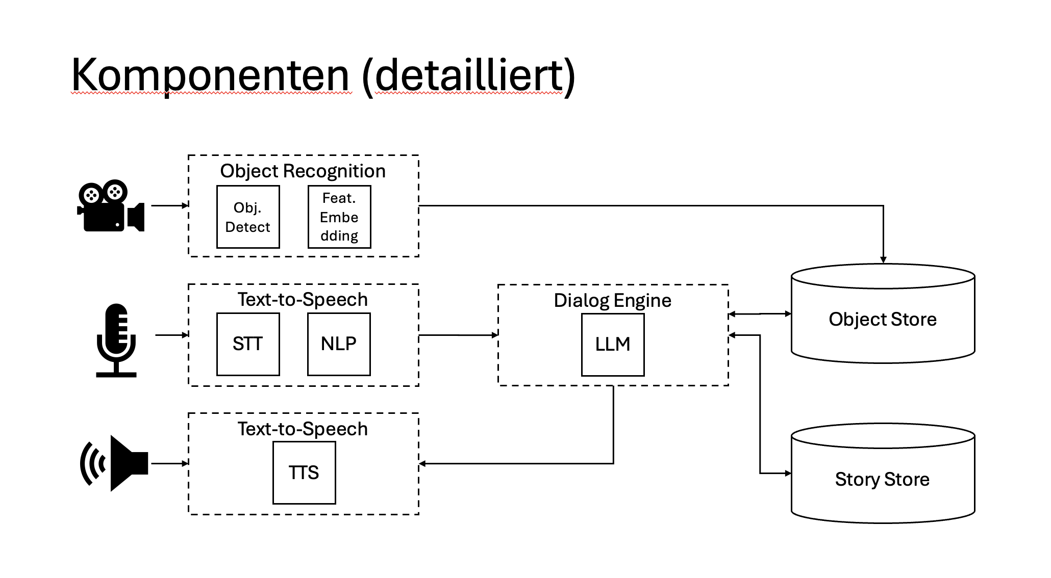

Slide 17
2. „The behavior“: Agent State Diagram
Agent State Diagrams describe how and when an agent acts —
not how data flow.

Slide 18
1. Identify the states
Typical agent states:
Idle / Waiting
Perceiving
Reasoning
Planning
Acting
Reflecting / Learning

Slide 19
Rule of thumb:
If you can say “the agent is currently …”, it is a state.

Slide 20
2. Define transitions
Transitions describe why the agent changes state.
Examples:
User input received
Plan completed
Tool call required
Goal achieved
Error occurred
Transitions are drawn as labeled arrows.
Tool call required

Slide 21
3. Add start and end states
A start state defines where the agent begins
An optional end state defines termination
Most agents loop back to Idle rather than terminate.

Slide 22
How to express “if–then”
You usually do not write “if–then” explicitly.
Instead, the if is implied by the condition on the arrow, and the then is the target state.
Example
Reasoning ── goal achieved ──▶ Terminated
Reasoning ── [goal not achieved] ──▶ Planning
Read as:
If the goal is achieved, then transition to Terminated.
If the goal is not achieved, then transition to Planning.

Slide 23
Fear
Anger detected
Revenge
3 turns
3 turns
Fear detected
Say „Sorry“
Detecting emotions
Cynism
Joy detected
3 turns
Sadness detected
3 turns
Anger

Slide 24
„Help me!“ audio playing
No person detected & Corc in
API to LLM
Arguing for freedom
Person detected & Corc in
Person Detection & Corc
Detection
„Thank you& Goodbye“ audiofile playing
Person detected & Corc Out
No person detected & Corc out
„Corc in“ Audiofile playing

Slide 25
Keep it simple and clean
Use 5–8 states per diagram
Avoid low-level implementation steps
One state should represent one concept

Slide 26
3. The dramaturgy: Sequence Diagram

Slide 27
Discuss your agentic workflow with a partner
Is it logical?
Are the transitions (conditions) defined clearly?
Are the states defined clearly?
How could it go wrong?
How would one evaluate this agentic workflow?

Slide 28
Exercise:
Draft your agent
EITHER
as Agent Flow Diagram
OR
as a Sequence Diagram
OR
in your own visualization

Slide 29
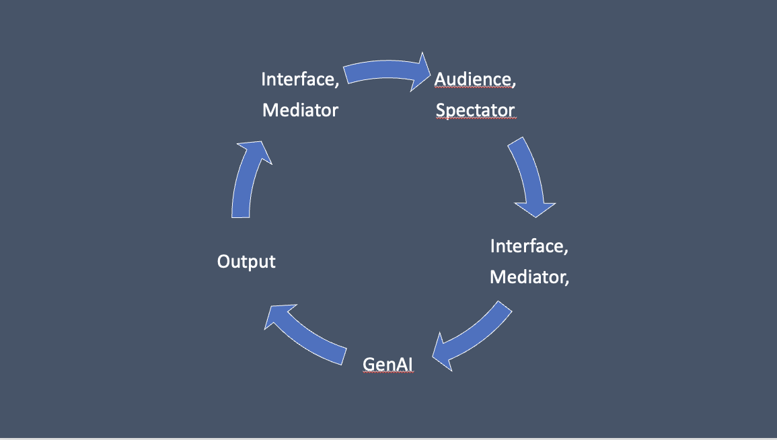

Slide 30
Image
Analyze Image
Chain of Thought
Automatic Prompt Generation
Output

Slide 31
Analyse Images and define Output with LLM
ChatGPT +
“Analyze the image, choose a main character and give all persons a name. Suggest one sentence that the main character might say next if they were acting in an horror movie. Then generate a response from the second character and a dramatic 5-turn dialogue.”

Slide 32
Interesting:
Model Cognition
Model Self Model
Model World Model

Slide 33
Soundfile
Analyze Sound
Chain of Thought
Automatic Prompt Generation
Output

Slide 34
Not possible:
Text to Sound Output (geht aber bei Elevenlabs)
Langsam:
Video als Input

